Slide 1
CIT 3103 Fundamentals of Internet Lecture 5
Introduction To G Suite

Slide 2
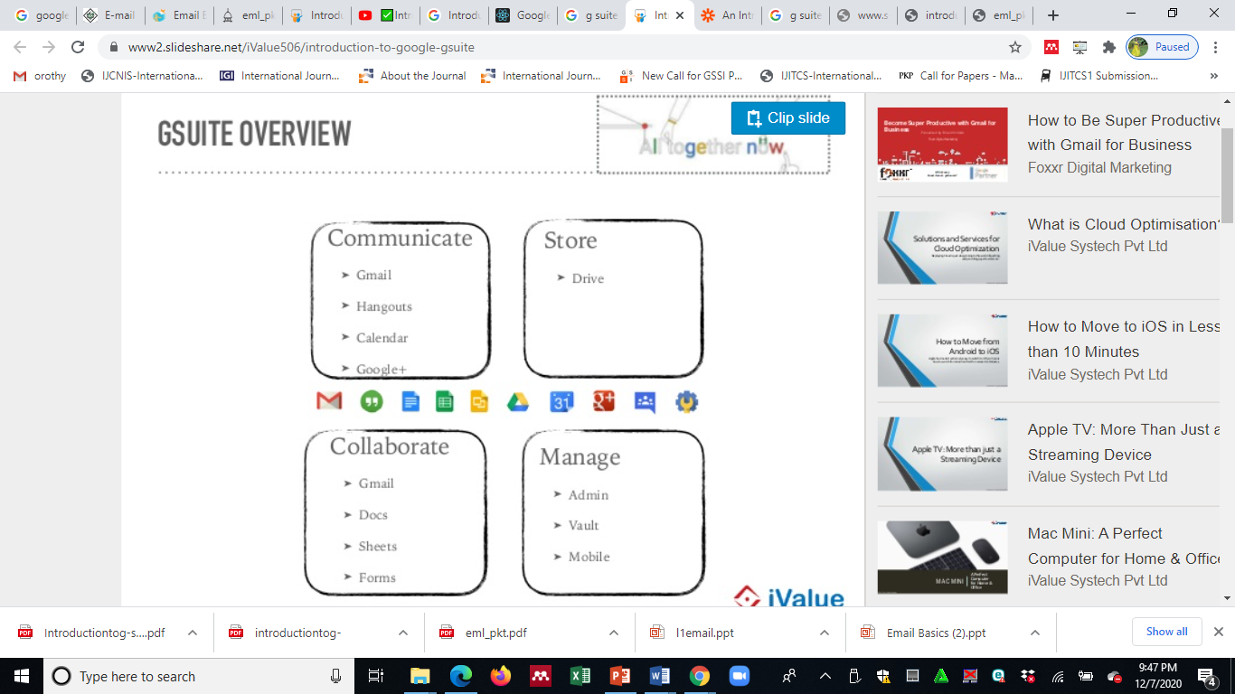
G-Suite Overview

Slide 3
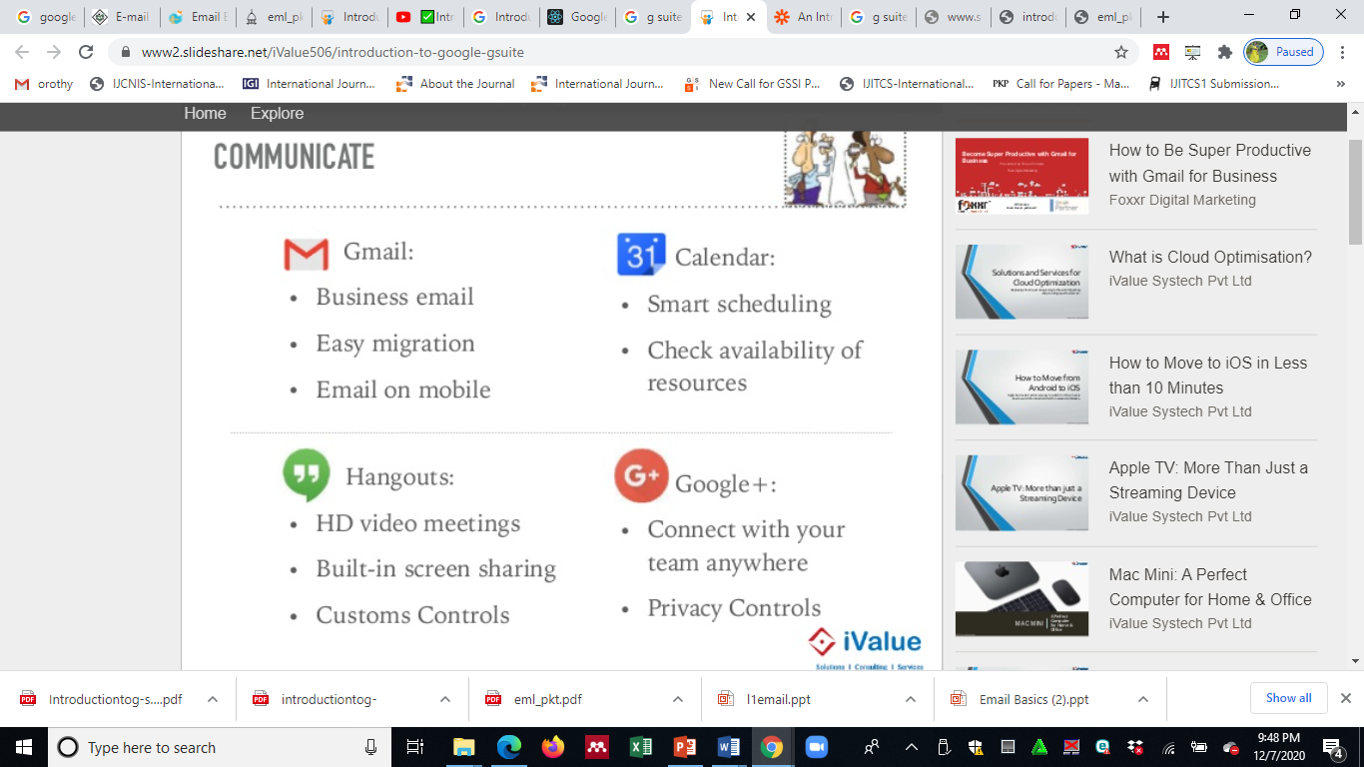
Communication G-Suite Tools

Slide 4
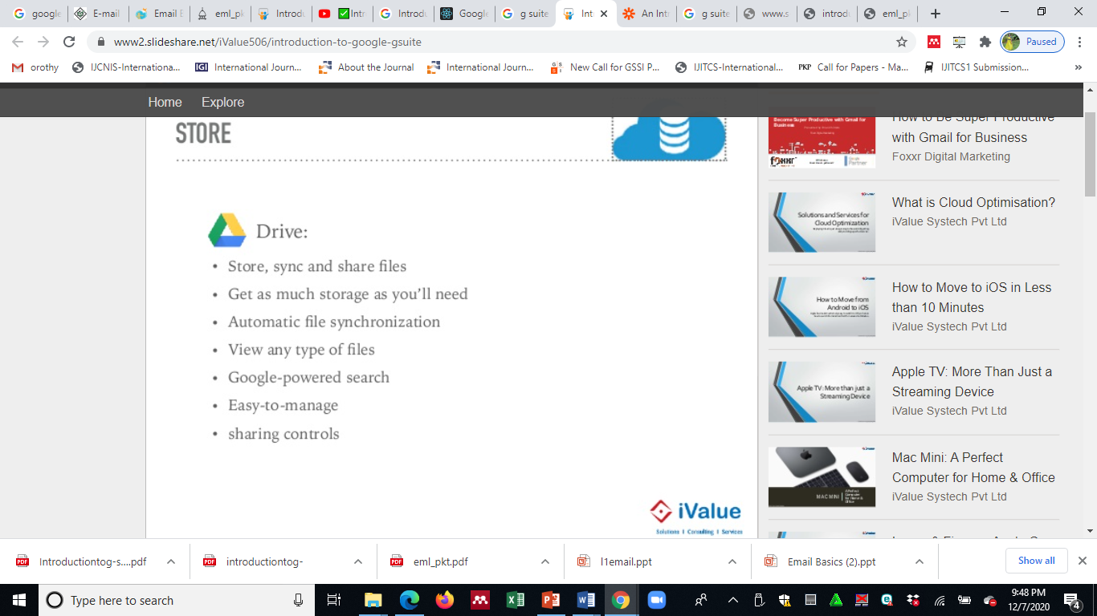
Storage G-Suite Tools

Slide 5
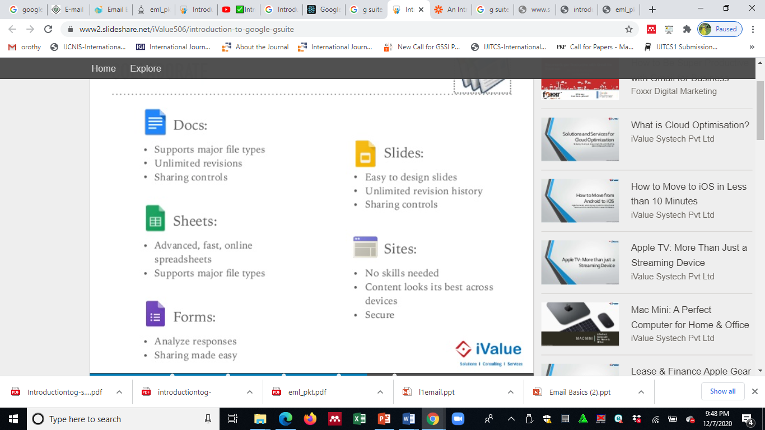
G-Suite Apps

Slide 6
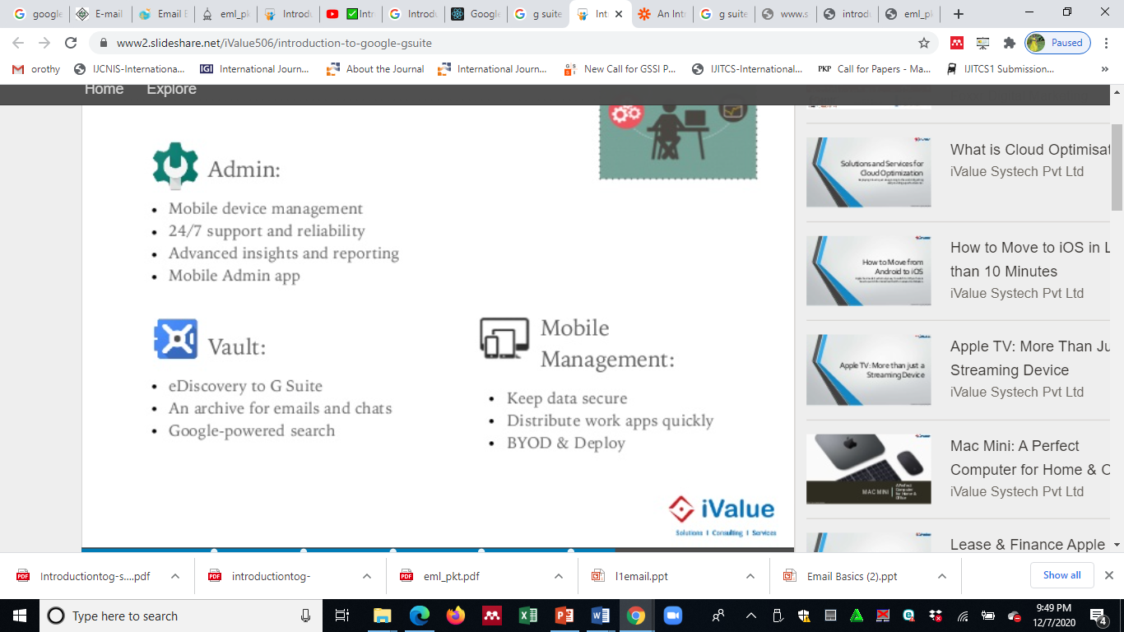
G-Suite Admin

Slide 7
G-Suite Class Exercise:
In class groups of five:
The student to use the G-Suite tools and apps work to be done in groups
Create a Google classroom to be done in groups
Create Google form about : “Life in Campus” with at least 10 closed ended questions in the questionnaire and upload the questionnaire to the google classroom
Use Google docs, Google sheets to be done in groups
Save their work to Google drive
Create an email using gmail and attach a document to the email and share with your group members

